Slide 1
Strategic & Board update annual member meeting 2024
Nicholas Johnson, Chairperson

Slide 2
Strategic & board update
State Super Operating Model
Options for investment management
Options for ‘Back Office’ outsourced administration services
Responsible Investment
Cyber Security and other risks

Slide 3
State super operating model
INVESTMENTS
Changing demographics and scale may require current investment operating model to evolve
Alternatives – in-house management vs. outsourcing investment management responsibility
How to maintain industry-leading investment team as scale changes

Slide 4
State super operating model
ADMINISTRATION
How to set the delivery model for administration services as member needs change
Transitioning from superannuation accumulation to retirement phase – services required will change
Outsourcing to Mercer Administration under contract till 2031
Best operating model for high-quality and low-cost services for the coming decades

Slide 5
RESPONSIBLE INVESTING
Framework to promote improved behaviours from the companies we invest in
Target 25% reduction in carbon emissions by 2025
Target 45% reduction in carbon emissions by 2030
Net zero target by 2050
Metrics show carbon emissions/intensity in the portfolio declining in line with our targets
Shareholder voting used to influence companies and encourage responsible operations

Slide 6
Cyber security & other risk
Cyber security risk now well recognised
Robust measures in place at State Super and external service providers
Particular emphasis on members private data
Financial and reputational consequences – we embed processes throughout the organisation to identify and help manage risk
Risk is a focus of the primary financial services regulator APRA
State Super’s oversight by NSW government (rather than APRA) – but we will implement APRA’s new enhanced risk management processes in coming year

Slide 7
Thank you!

Slide 8
Fund update annual member meeting 2024
John Livanas, Chief Executive Officer

Slide 9
highlights
OUR PEOPLE
Staff retention over 90% and Employee Engagement score 75%
Commitment to learning and development
Strong culture and employee value proposition
OUR MEMBERS
Annual satisfaction ratings high - pension members the most satisfied
Annual Member Meeting well attended with 800 registered last year
Website traffic increasing – access to your account online
Free education seminars attended by 3,000 members

Slide 10
investments
DEFINED BENEFITS
Continued partnership with TCorp
Returns of 7.5% (7.4% over 10 years)
Contribution funding framework to support full funding and optimise investment strategies
DEFINED CONTRIBUTIONS
Returns of 9.1% Growth, 8.3% Balanced and 7.1 % Conservative
High returns while managing liquidity and outflows

Slide 11
State super CORPORATE PLAN
5 KEY OBJECTIVES
Member: Deliver relevant and reliable member experiences
Investment: Set and meet our risk/return objectives
Governance: Maintain an effective governance framework
Stakeholders: Maintain positive relationships with stakeholders
Operating Model: Strengthen State Super’s operating model and workforce

Slide 12
Member experience
Redeveloped research program to capture member satisfaction with new partner
Align services to evolving member needs
Member engagement program continues to be refined
Successful completion of largest system transition – Acurity system, a contemporary and more secure platform

Slide 13
GOVERNANCE & STAKEHOLDERS
Board demonstrates high performance and robust framework
Comply with HOGA – “Heads of Government Agreement” requirements
Positive relationship with stakeholders who rate us highly for integrity and reliability
Strong brand and profile – focus on members’ best interests
Risk culture survey emphasises “Integrity, Transparency, Challenge and Accountability”
Responsible Investing – NOJA Power awarded 2024 Australian Export Award of “Sustainability and Green Economy”.

Slide 14
WORKFORCE STRATEGIES
Workforce strategies that focus on building capability and employee wellbeing
High employee engagement one measure of our positive workplace culture
Support learning and development
Recruit individuals who fit culture and focus on members
Strong culture means our people are committed to deliver ongoing member support

Slide 15
Member advisory forum
Member Advisory Forum September 2024
Online gathering for members to share their views
Focus on financial wellbeing in retirement
70 members participated – Education sector
Key message -
Value of defined benefit schemes for a dignified retirement
Concerns about housing affordability for the new generation
Intergenerational support

Slide 16
OUR Future
State Super has been a consistent leader in superannuation in Australia
Developing entities -
Dexus
StatePlus (Aware)
Pioneering innovations in machine learning and AI
Initiatives in investments and scheme management/administration
Ongoing commitment to members and investment returns

Slide 17
Thank you!

Slide 18
Investment Update annual member meeting 2024
Charles Wu, CFA, Chief Investment Officer

Slide 21
Member investment choice strategies to 30 June 2024
 | 1 year | 2 year | 3 year | 5 year | 10 year
Growth | 9.1% | 9.5% | 5.7% | 6.5% | 7.3%
Balanced | 8.3% | 8.2% | 5.1% | 5.3% | 6.0%
Conservative | 7.1% | 6.6% | 4.7% | 4.5% | 4.8%
Cash | 4.4% | 3.5% | 2.4% | 1.6% | 1.8%

Slide 23
Option​ | Peer Group​ | 1Y Sharpe​ | 3Y Sharpe​ | 5Y Sharpe​ | 7Y Sharpe​ | 10Y Sharpe​
DC Growth​ | Balanced ​ (60-76)​ | 29th / 166​ | 9th / 124​ | 2nd / 122 ​ | 1st / 109​ | 1st / 87​
DC Balanced​ | Conservative Balanced ​ (41-59)​ | 1st / 91​ | 1st / 61​ | 1st / 60​ | 1st / 54​ | 1st / 42​
DC Conservative​ | Capital Stable​ (20-40)​ | 1st / 73​ | 1st / 59​ | 1st / 58​ | 1st / 55​ | 2nd / 42​

Slide 24
Thank you!

Slide 25
Member ENGAGEMENT annual member meeting 2024
Nada Siratkov, Chief Experience Officer

Slide 26
State super established 1919
State Super marked 100 years of the organisation in 2019.
Play Video

Slide 27
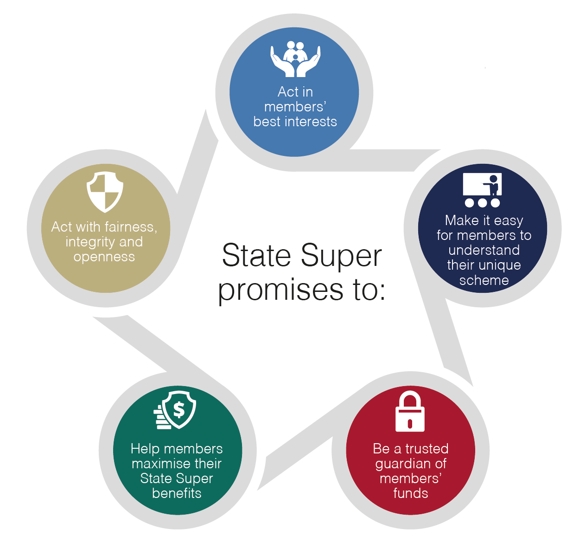
Our member beliefs
State Super promises to:
Act in members’ best interests
Act with fairness, integrity and openness
Make it easy for members to understand their unique scheme
Help members maximise their State Super benefits
Be a trusted guardian of members’ funds

Slide 28
member satisfaction SURVEY
Our Member Satisfaction research survey is conducted around this time each year.
Last year’s results continue to show high scores for various services offered to members. Scores were given out of 10 for –
Financial Planning (8.1)
Interview/Member Service appointment (8.1)
Telephone Service (7.8)
Our Pension members were the most satisfied overall –
Financial Planning (8.6)
Telephone Service (8.5)
Investment Performance (8.1)

Slide 29
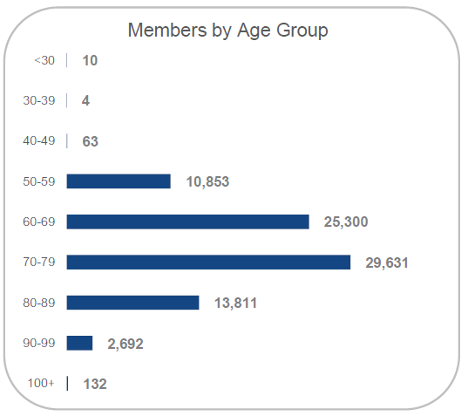
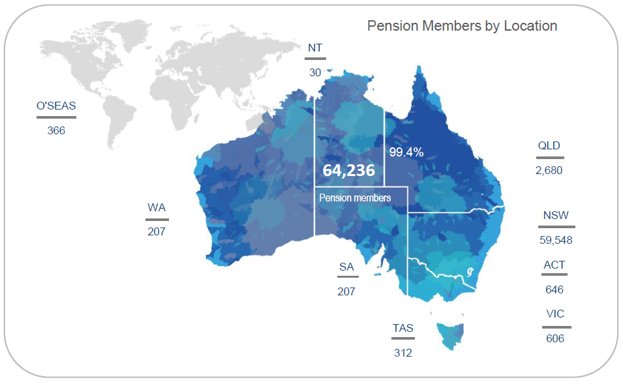
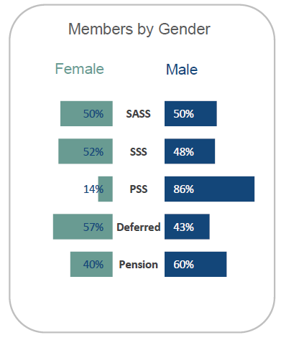
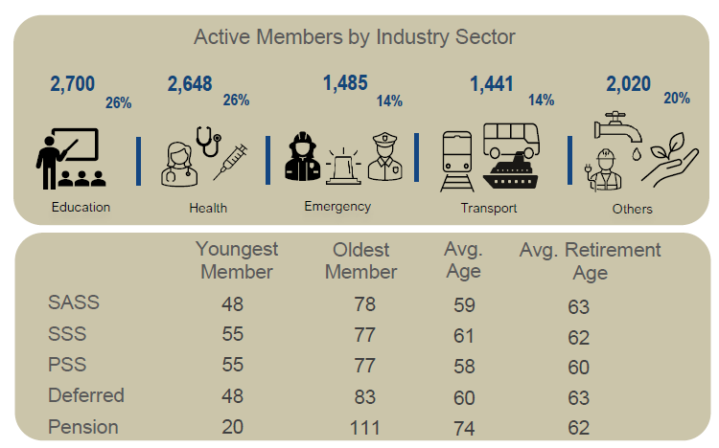
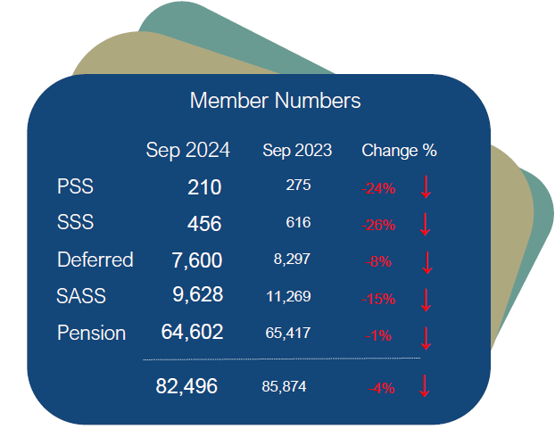
MEMBER SNAPSHOT

Slide 30
Our evolving membership
Membership type | 5 years ago | Today | 5 years in future
 | 2019 | 2024 | 2029
Active | 21,972 | 10,795 | 4,132
Deferred | 10,606 | 7,786 | 2,924
Pension | 66,734 | 64,857 | 59,675
TOTAL | 99,312 | 83,438 | 66,731
*As at 30 June

Slide 31
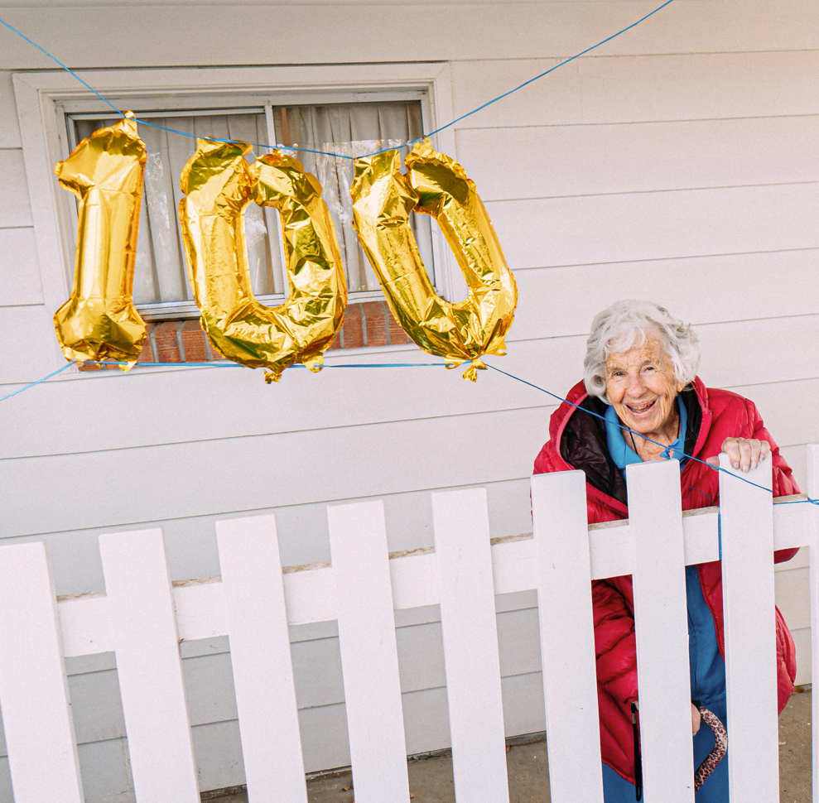
Our CENTENARIANS – the “100+ club”
A snapshot of State Super Centenarians
Members 100+ | 131
Members 110+ | 1 - spouse pension member 111-year-old “Annunziata”
Gender | 102 Women (77%) 30 Men (23%)
Type of pension | 44 primary pension (33%) 88 spouse pension (67%)
Industry | 36% were employed (or spouse employed) by NSW Department of Education
Years on pension | Average of 31 years
Residence | 92% live in NSW

Slide 32
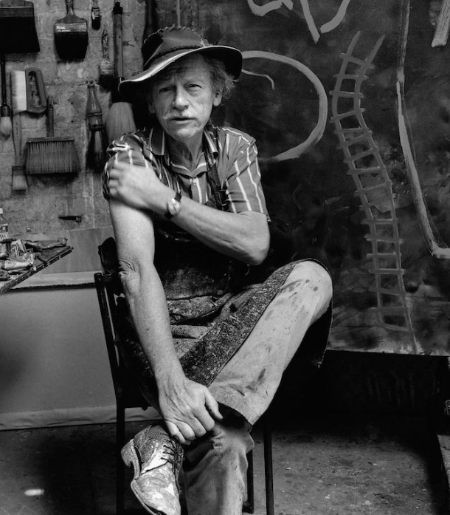
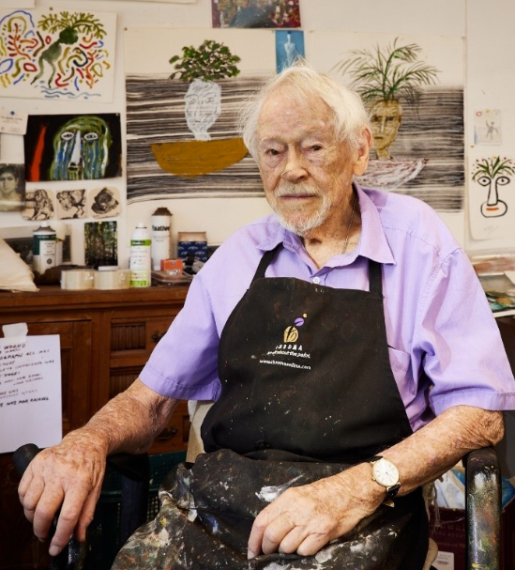
VALE GUY WARREN – PENSION MEMBER AGED 103
Australia’s oldest working artist passed away in June of this year
Artist (Painter) and Educator, Guy won the Archibald Prize in 1985
Member of the Order of Australia 2014
State Super Pension Member for 38 years
Last year we interviewed Guy for a video we showed at the Annual Member Meeting
Guy spoke about life, art and the benefits of having a lifetime pension.

Slide 33
PENSIONS - CPI increase +3.8%
WHAT’S IN A CPI BASKET?
Health
Transport
Communication
Recreation & Culture
Education
Insurance & financial services
Food & non-alcoholic beverages
Alcohol & tobacco
Clothing & footwear
Housing
Furnishing, household equipment/services
State Super pension members enjoy an important benefit that offsets cost-of-living pressures
In the 1970s legislation was introduced to index State Super pension to the CPI (Consumer Price Index)
CPI measures the change in the price of a fixed “basket” of goods and services
Pensions adjusted each October to reflect CPI
Most years this represents an increase in pension amounts
For 2024 the adjustment rate was 3.8% (based on CPI Sydney Index).
Compares to an Australia wide CPI rise which was also 3.8%

Slide 34
YOUR QUESTIONS – your PERSONAL account
State Super Customer Service
What they can help you with:
Get a lump sum benefit estimate or pension estimate
General information about how your State Super scheme works
Superannuation rules
Which administrative forms to use/how to complete
Documents signed/certified (visit in-person for this service)
Get in touch: Call 1300 130 096 Email enquiries@stc.nsw.gov.au
To book in-person appointments (Sydney CBD/Wollongong or via Zoom) call above number.

Slide 35
YOUR QUESTIONS – webinar
Join a free “Webinar” (online Seminar)
What they can help you with:
Presented on State Super’s behalf by qualified Aware Super financial planners
Learn more about your scheme – how it works, what your choices are
Making decisions about your employment and how it affects your benefits
Centrelink rules and benefits you may be eligible for
How a financial plan can help you make the most of your super
Get in touch: Call 1800 620 305 Visit aware.com.au/state-super/events

Slide 36
YOUR QUESTIONS – RETIREMENT & FINANCIAL PLANNING
Aware Super (or other Financial Planning providers)
What they can help you with:
How a financial plan can help you make the most of your super
Best timing for your retirement.
Lump sum or roll over to another fund?
Retirement income strategies, tax and investing
Government Age Pension eligibility
Advice on Estate Planning and Aged Care options
First appointment free of cost/obligation for State Super members
Get in touch: Call 1800 841 633 Visit aware.com.au/statesuper

Slide 37
Thank you!

