Slide 1
INVESTMENT UPDATE annual member meeting 2023
Charles Wu, Chief Investment Officer

Slide 2
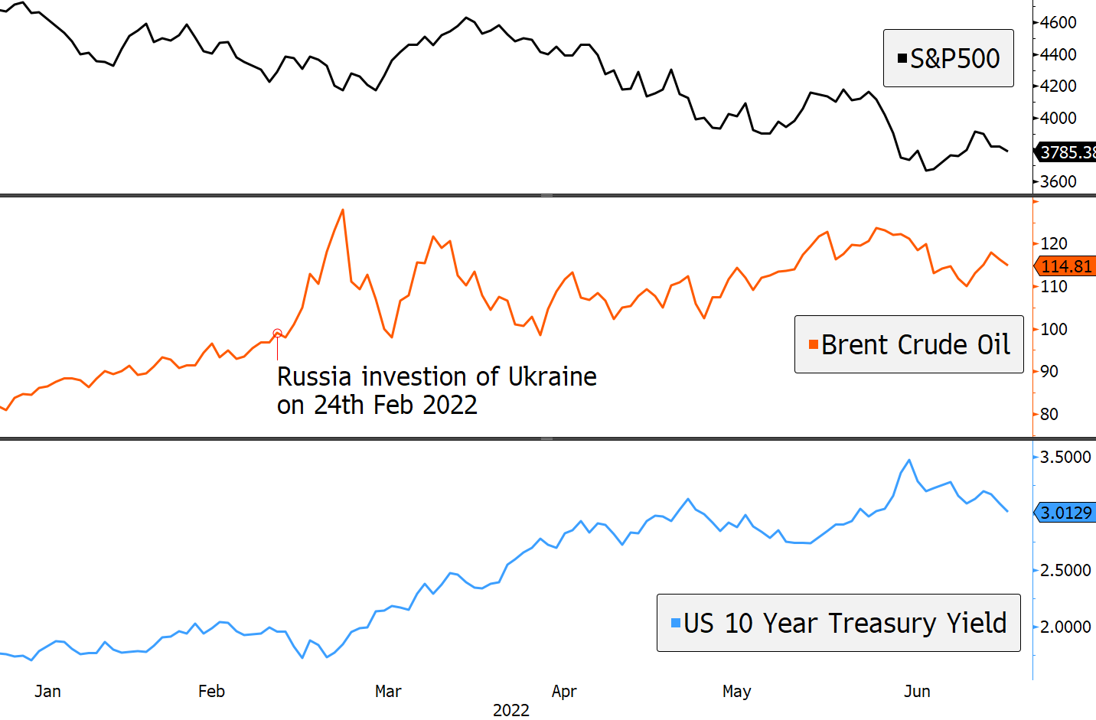
UKRAINE-RUSSIA CONFLICT
    Equity market fell
    Disruption to supply chains
    Surge in energy prices
    Wave of inflation
    Sharp rise in interest rates
    Repricing of assets (listed and unlisted)

Slide 3


Geopolitical tensions – china and u.s
    Further drawdowns in equity markets
    Exacerbated inflation
    Increase in production costs fed inflation spiral
    Softening in the equity market by November 2022
    Some technology companies down by over 30%

Slide 4

Introduction of gpt
    Notable shift in market sentiment with launch of GPT (November 2022)
    Equity market shift – favourable
    Bond market remained volatile
    Importance of continuous learning and adaptation to evolution in the market
    Bond fluctuation of almost 50% from peak to trough (18 months)

Slide 5
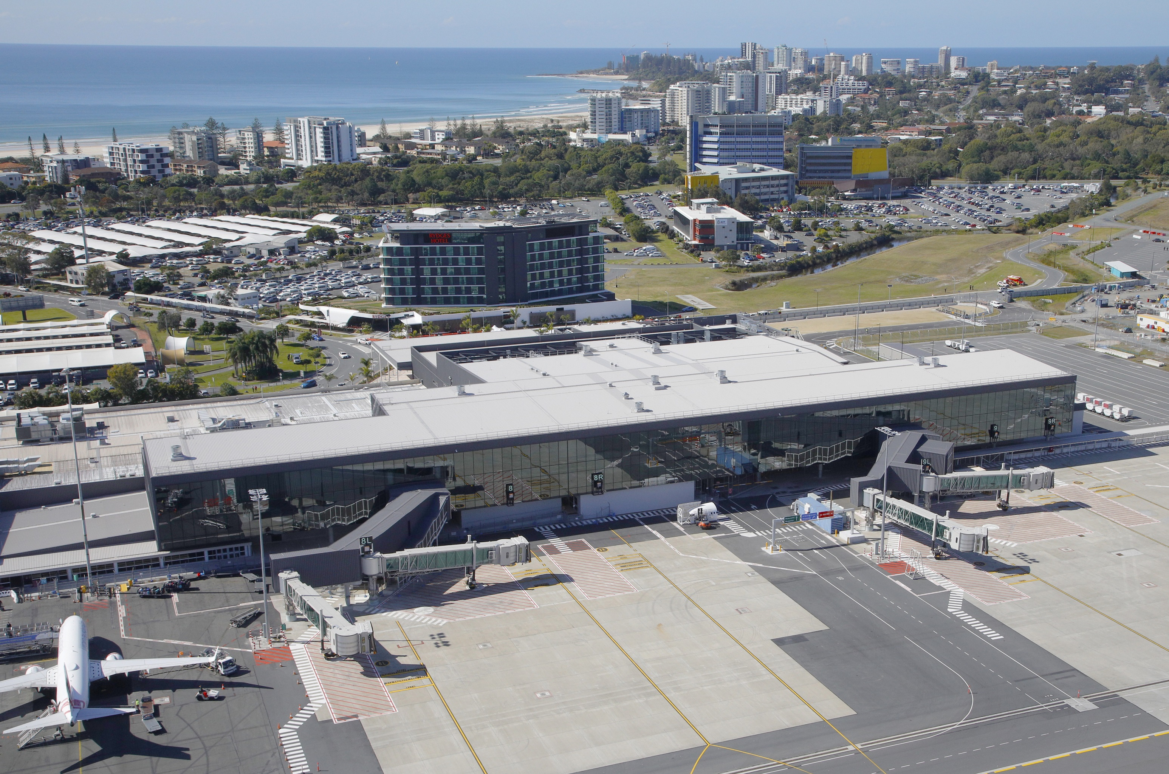
Looking forward
    Continue to fortify our portfolio in times of uncertainty
    Maintain sufficient liquidity to meet payments
    Strategy – gradually reduce holdings in illiquid assets (e.g. sale of equity in Queensland Airport)
    New challenges but also new opportunities in 2024
Gold Coast Airport

Slide 6
Thank you!

Slide 7
Member ENGAGEMENT annual member meeting 2023
Nada Siratkov, Chief Experience Officer

Slide 8
Our dna
1919
1919 - 1985
1985 - 1988
1988 - 1996
1996 - present
State Superannuation Board
State Authorities Superannuation Board
State Provident Fund Management Board
State Public Service Superannuation Board
State Super (SAS Trustee Corporation)

Slide 9

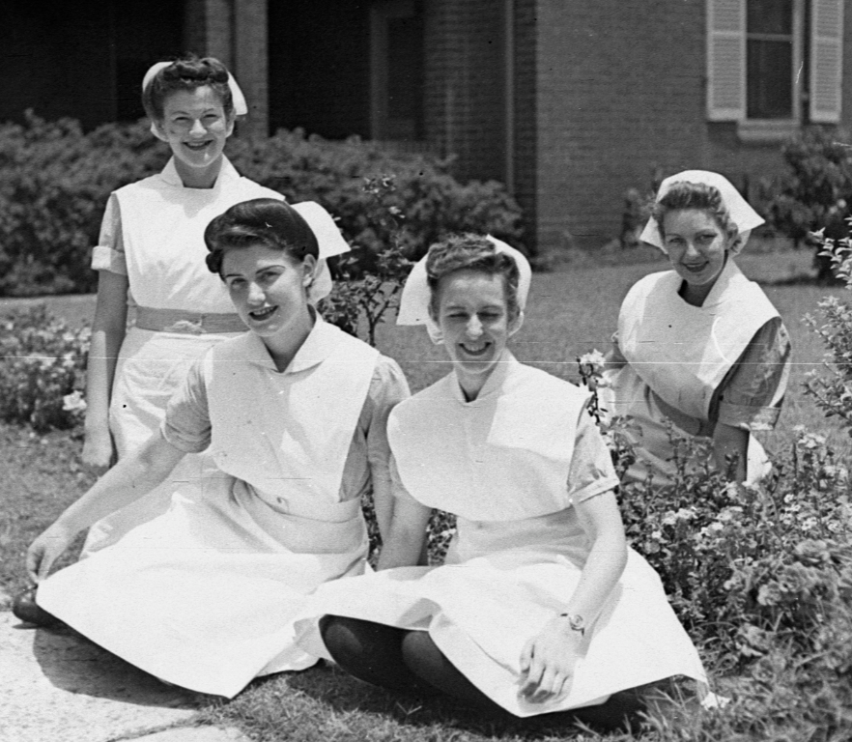
State super established 1919
State Super marked 100 years of the organisation in 2019.
NSW Government started the scheme on 1 July 1919 under the Superannuation Act (1916).
Compulsory for permanent, salaried employees of the NSW public service and teaching service.
Provided for a “Defined Benefit” pension at retirement (and invalidity/death pension).
Reversionary pension for the female spouses of members

Slide 10
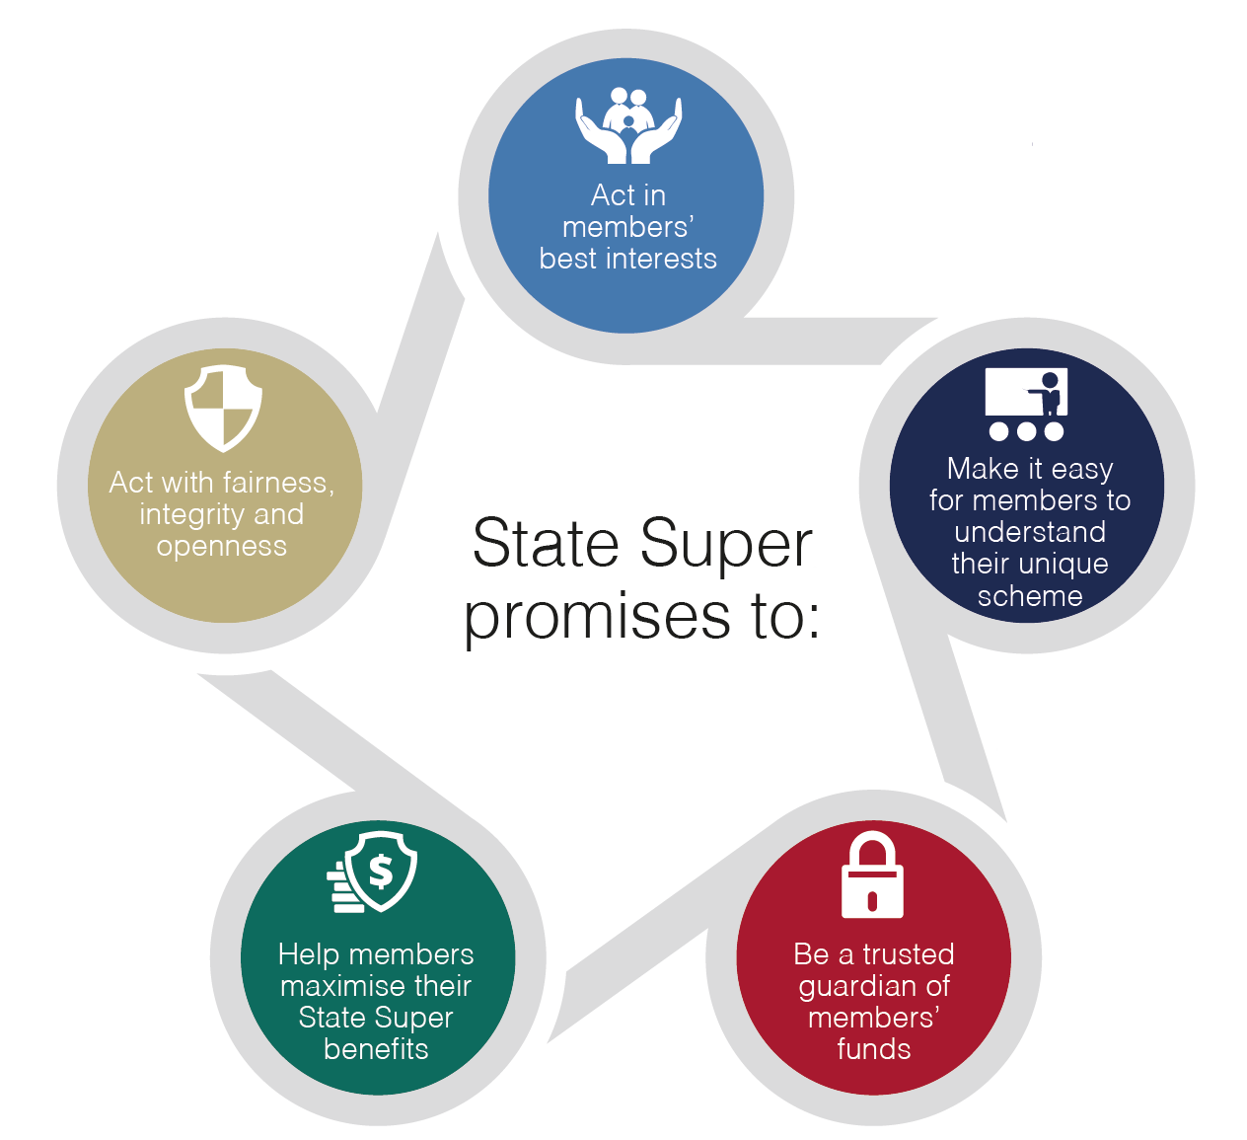
Our member beliefs
    State Super promises to:
    Act in members’ best interests
    Act with fairness, integrity and openness
    Make it easy for members to understand their unique scheme
    Help members maximise their State Super benefits
    Be a trusted guardian of members’ funds

Slide 11
member satisfaction
    Our annual Member Satisfaction survey conducted by Woolcott Research, continues to show high scores for various services offered to members. Scores were given out of 10 for –
    Telephone Service (8.1)
    Interview Service (7.9)
    Financial Planning (7.8)
    Seminars (7.6)
    Pension members were the most satisfied overall, scoring our Telephone Service a 9.0 (compared to the national average of 8.1).

Slide 12
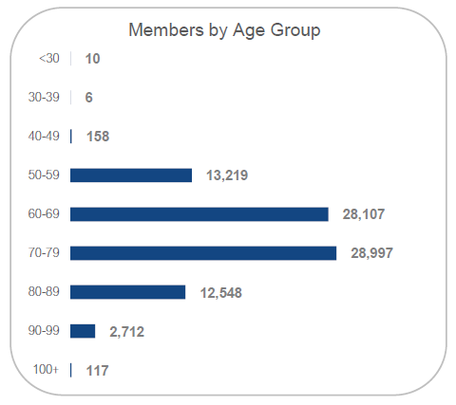
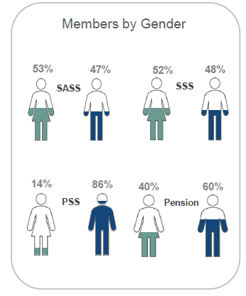
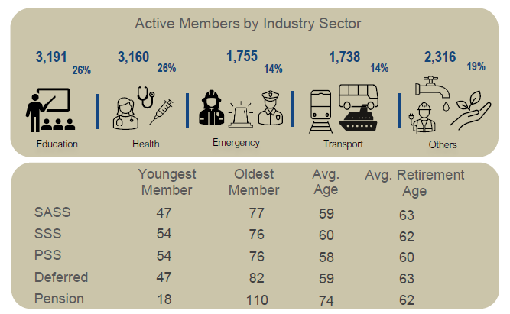
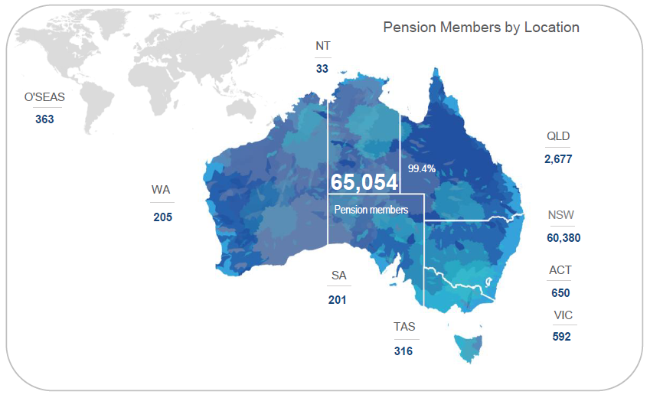
MEMBER SNAPSHOT
Member Numbers
as at 30 September 2023
PSS
275
SSS
616
Deferred
8,297
SASS
11,269
Pension
65,417
85,874

Slide 13
Our evolving membership
A snapshot of scheme membership - 5 years ago & 5 years in future*
Membership type | 2018 | 2023 | 2028
Active | 25,031 | 12,741 | 5,201
Deferred | 11,111 | 8,588 | 3,582
Pension | 66,492 | 65,511 | 60,856
TOTAL | 102,634 | 86,840 | 69,639
*As at 30 June

Slide 14

PENSION member - CPI CHANGES
  WHAT’S IN A CPI BASKET?
  Health
  Transport
  Communication
  Recreation & Culture
  Education
  Insurance & financial services
  Food & non-alcoholic beverages
  Alcohol & tobacco
  Clothing & footwear
  Housing
  Furnishing, household equipment/services
State Super pension members enjoy an important benefit that offsets cost-of-living pressures
In the 1970s legislation was introduced to index State Super pension to the CPI (Consumer Price Index)
CPI measures the change in the price of a fixed “basket” of goods and services
Pensions are adjusted each October to reflect CPI movement
Most years this represents an increase in pension amounts
For 2023 the adjustment rate was 6.6% (based on CPI Sydney Index). This compares to an Australia wide CPI rise of 6.0%

Slide 15
HISTORICAL CPI changes to PENSIONS
Year | CPI increase | Year | CPI increase | Year | CPI increase | Year | CPI increase | Year | CPI increase | Year | CPI increase
- | - | 1980 | 11.0% | 1990 | 8.1% | 2000 | 3.3% | 2010 | 2.9% | 2020 | -1.0%*
- | - | 1981 | 8.9% | 1991 | 2.8% | 2001 | 6.3% | 2011 | 3.8% | 2021 | 4.1%
- | - | 1982 | 11.1% | 1992 | 1.0% | 2002 | 2.8% | 2012 | 1.3% | 2022 | 5.3%
1973 | 12.5% | 1983 | 11.0% | 1993 | 1.8% | 2003 | 2.4% | 2013 | 2.6% | 2023 | 6.6%
1974 | 14.3% | 1984 | 3.0% | 1994 | 1.5% | 2004 | 2.3% | 2014 | 2.8% | - | -
1975 | 16.9% | 1985 | 6.5% | 1995 | 4.9% | 2005 | 2.4% | 2015 | 2.2% | - | -
1976 | 11.9% | 1986 | 8.8% | 1996 | 3.9% | 2006 | 3.8% | 2016 | 0.9% | - | -
1977 | 11.9% | 1987 | 9.3% | 1997 | 0.3% | 2007 | 1.7% | 2017 | 2.2% | - | -
1978 | 7.5% | 1988 | 7.3% | 1998 | 1.3% | 2008 | 4.3% | 2018 | 2.1% | - | -
1979 | 9.8% | 1989 | 8.0% | 1999 | 1.3% | 2009 | 1.3% | 2019 | 1.7% | - | -
* Negative CPI of -1.0% resulted in no change to pension amounts in 2020, but was offset against the following year

Slide 16

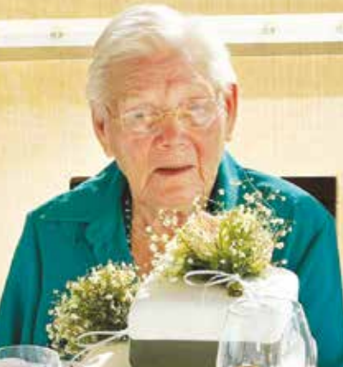
Our CENTENARIANS – the “100+ club”
A snapshot of State Super Centenarians
Members 100+ | 117
Gender | 92 Women (79%) 25 Men (21%)
Type of pension | 38 primary pension (32%) 79 spouse pension (68%)
Industry | 51% were employed (or their spouse employed) by NSW Department of Education
Years receiving pension | Average of 30 years
Residence | 90% live in NSW
Pension member Joyce Wright as a teenager
Joyce celebrating 100 years

Slide 17
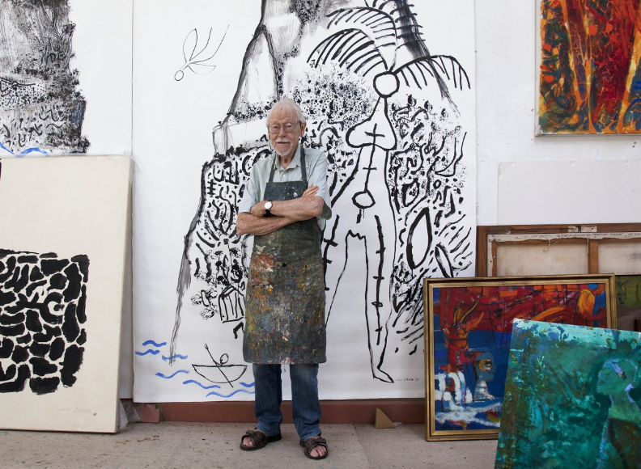
Our CENTENARIANS
Guy Wilkie Warren AM
Date of birth | April 1921 (aged 102)
Occupation | Artist (Painter), Educator
Awards | Archibald Prize 1985 Member of the Order of Australia 2014
Scheme employer | Sydney College of Arts University of Technology Sydney

Slide 18
Thank you!

