Slide 1
Board UPDATE member meeting 2022
Nicholas Johnson, Chair

Slide 2
Board focus
Three front-of-mind issues for the State Super Board.
These issues are receiving constant attention and oversight:
Data and cyber crime
Responsible Investment
Evolving member experience

Slide 3
Data and Cyber Crime
Cyber crime is increasing, with rising sophistication, scale and frequency.
Data is both the foundation and the aim of most cyber crime
- STC holds much highly sensitive Member data
Major data-focussed work programmes nearing completion
to identify exactly what ‘critical data elements’ are held.
to know how and where the data elements are stored.
to allocate responsibilities for data to specific individuals.
to confirm security arrangements for all data elements.
to ensure that data held or used by external service suppliers are subject to these consistent State Super standards.
Result is a detailed Data Risk Management Framework - approved by the Board last week, fully aligned with APRA regulatory guidelines, but subject to constant review and improvement.

Slide 4
Responsible investment
State Super has a strong proactive approach to environmental, social and governance issues while delivering above average investment returns.
carbon footprint measured with hard metrics against real benchmarks
credible investment ‘road map’ to net zero carbon by 2050
interim target of a 45% reduction in carbon emissions by 2030
regular Board review - optimal results for members without ‘greenwashing’
’Engagement’ preferred to ‘divestment’
proactive and transparent engagement with companies results in earlier action by high carbon footprint companies
short-term equity sales can produce highly discounted price, reducing underlying long-term value of Members’ assets
Similar proactive approach to social and governance issues.

Slide 5
Evolving Member experience
Over the next five years almost all of State Super members will have moved into, or be close to, their retirement phase.
total members falling from 90,000 to 73,000 (62,000 pension members)
Change in member demographics and needs coupled with new technology will offer opportunities for changing our operating model.
central activities of overseeing investment, paying pensions and managing members’ interests will continue, but
member questions and requirements may change
organisation will develop to respond to changed member interactions efficiently and cost-effectively
services will evolve with new administration ‘platform’, allowing best-practice experience for members

Slide 6
Summary
These three themes are intended to illustrate how the State Super Board takes a proactive approach to identifying and responding to emerging risks and opportunities.

Slide 7
Thank you!

Slide 8
FUND UPDATE Member Meeting 2022
John Livanas, Chief Executive Officer

Slide 9
Who is state super?
State Super Purpose – To pay member benefits as they fall due and provide a positive member experience
State Super Mission – Provide high quality superannuation services to members to maximise their superannuation and to support the NSW Government in meeting its funding objective
Four public sector schemes (closed to new members):
SSS (pension)
SASS (lump sum)
PSS (pension)
SANCS (lump sum)
Commenced 1919
Closed 1985
Commenced 1988
Closed 1992
Commenced 1907
Closed 1988
Commenced 1988
Closed 1992
Notes:
Thank you Nick, and I’d also like to acknowledge the Board members present today.
I’d also like to welcome all our members here today. Thank you for the time you’ve taken to join us, and we are grateful for your questions. We’ll try to answer them as best as we can.
Over the years, you have been the reason why we are here serving you, and it is a privilege and honour to do so. My team and I are committed to making your experience with State Super the very best we can.
I’d like to start by noting our purpose and mission:
State Super Purpose – To pay member benefits as they fall due and provide a positive member experience
State Super Mission – Provide high quality superannuation services to members to maximise their superannuation and to support the NSW Government in meeting its funding objective
I’d also like to acknowledge my Executive Team: You’ll hear from some of them today:
Charles Wu is our CIO and he is joined in investments by Keri Pratt and Jason Hazell
Nada Siratkov is our CXO
They’ll each talk about their areas shortly
Allan Parapuram is our CLO and CoSec
Nish Patel is here to, as our CFO
Jag Narayan is our CRO

Slide 10
The year in review – resilient in the face of disruption
A year of change with disconnected events creating disruption.
Floods and droughts in Australia and globally disrupting supplies and increasing costs.
War in Ukraine impacting gas prices and creating inflation.
Geopolitical tensions with China and de-globalisation adding to disruptions.
The rapid increase in Cyber Crime.
While we can’t predict the future, we can aim for resilience in all we do. And this resilience is highlighted in our continued ability to deliver on our member promises: in services and in investment returns. This is particularly important because we outsource most of our activities.
Charles Wu, our CIO will show performance results during a challenging financial market environment.
Nada Siratkov, our CXO, will highlight how her team spends time understanding and managing risks in service delivery and understanding the risks of data security.
Notes:
Thank you Nick, and I’d also like to acknowledge the Board members present today.
I’d also like to welcome all our members here today. Thank you for the time you’ve taken to join us, and we are grateful for your questions. We’ll try to answer them as best as we can.
Over the years, you have been the reason why we are here serving you, and it is a privilege and honour to do so. My team and I are committed to making your experience with State Super the very best we can.
I’d also like to acknowledge my Executive Team: You’ll hear from some of them today:
Charles Wu is our CIO and he is joined in investments by Keri Pratt and Jason Hazell
Nada Siratkov is our CXO
They’ll each talk about their areas shortly
Allan Parapuram is our CLO and CoSec
Nish Patel is here to, as our CFO
Jag Narayan is our CRO
I’ll start about describing the year we’ve had – again a year of enormous challenges and events such as:
Floods and Droughts in Australia and Globally
The war in Ukraine and the implications for energy costs and inflation
Increasing Interest rates resulting from Reserve Banks trying to moderate inflation expectations
The rise in geopolitical tensions with China and others
And the rapid increase in Cyber Crime
And while we cannot predict the future, we can aim for resilience in what we do
Charles Wu and Nada Siratkov will each talk briefly about investments and member services; Charles showing the performance results and Nada about and managing risks in delivering services to you and understanding the risks of data security.
I should add importantly, that unlike other very large Super funds, we outsource most of our services. But in doing so, we understand that the responsibility is ultimately ours, and as such we focus extensively on understanding our services provider businesses and in managing risks for our members.

Slide 11
Net-zero Objective and Responsible Investing
Climate Risk
In December 2021 we announced that our investment strategy would have an objective to achieve net- zero carbon intensity in our investment portfolios by 2050, in alignment with the objectives of the Paris Agreement. To set our objectives we undertook to:
Conduct an extensive assessment of carbon intensity in current portfolio.
Understand the feasibility of a path that would progressively reduce carbon intensity, and identified the specific milestones.
Responsible Investing (Environmental, Social and Governance risks (ESG))
Identifying Environmental, Social and Governance Risks.
Implement investment strategies to minimise investment risk.
Engaging with companies on governance, gender equality, Modern Slavery and Anti-money laundering.
Notes:
I’d like to focus now on how we are responding to Climate Risk in our Investment Strategies, and how we think about Responsible Investing (or ESG issues)
We believe Climate Risk is a significant risk in our investments through the impact that climate change will have on our investments. These risks include the direct effects of climate change on our real assets – such as ports for example. However climates risks also arise where assets that we own, fall in value because others are not willing to pay for them. What are called ‘stranded assets’
As such we have looked to identify and manage this risk, by setting targets to reduce the exposure our investments have to Climate Risk. After months of analysis, we concluded that, as part of our Investment Strategy risk mitigation, we should minimise over time, the exposure our investments have to ‘carbon intensity’.
In December 2021, we announced that our investment strategy would have an objective to achieve net- zero carbon intensity in our investment portfolios by 2050. This being in alignment with the objectives of the Paris Agreement with the Paris Agreement. To set our objectives we undertook to:
Conduct an extensive assessment of carbon intensity in current portfolio
Understand the feasibility of a path that would progressively reduce carbon intensity, and identified the specific milestones
I’d now also like to talk about Responsible Investing in general. Our investment strategy has identified that being ‘responsible in our investments’ can mitigate investment risks.
This means identifying Environmental (which includes climate risk), Social and Governance Risks in our portfolio, and taking steps to minimise these.
And, understanding that we own companies for a very long time, engaging with companies on governance, gender equality, Modern Slavery and Anti-money laundering
Our central belief is that engagement can change corporate behaviour, and in doing so, minimises the risks in our portfolio, as well as helping society and the environment. Of course where we believe our investment strategies don’t achieve the desired outcomes, we have in our power the ability to make investment strategies to exclude certain categories of companies. We have done this in the past with companies that were predominantly in tobacco manufacturing, and in the manufacturing of cluster munitions. Sadly, as an observation, those companies still exist.

Slide 12
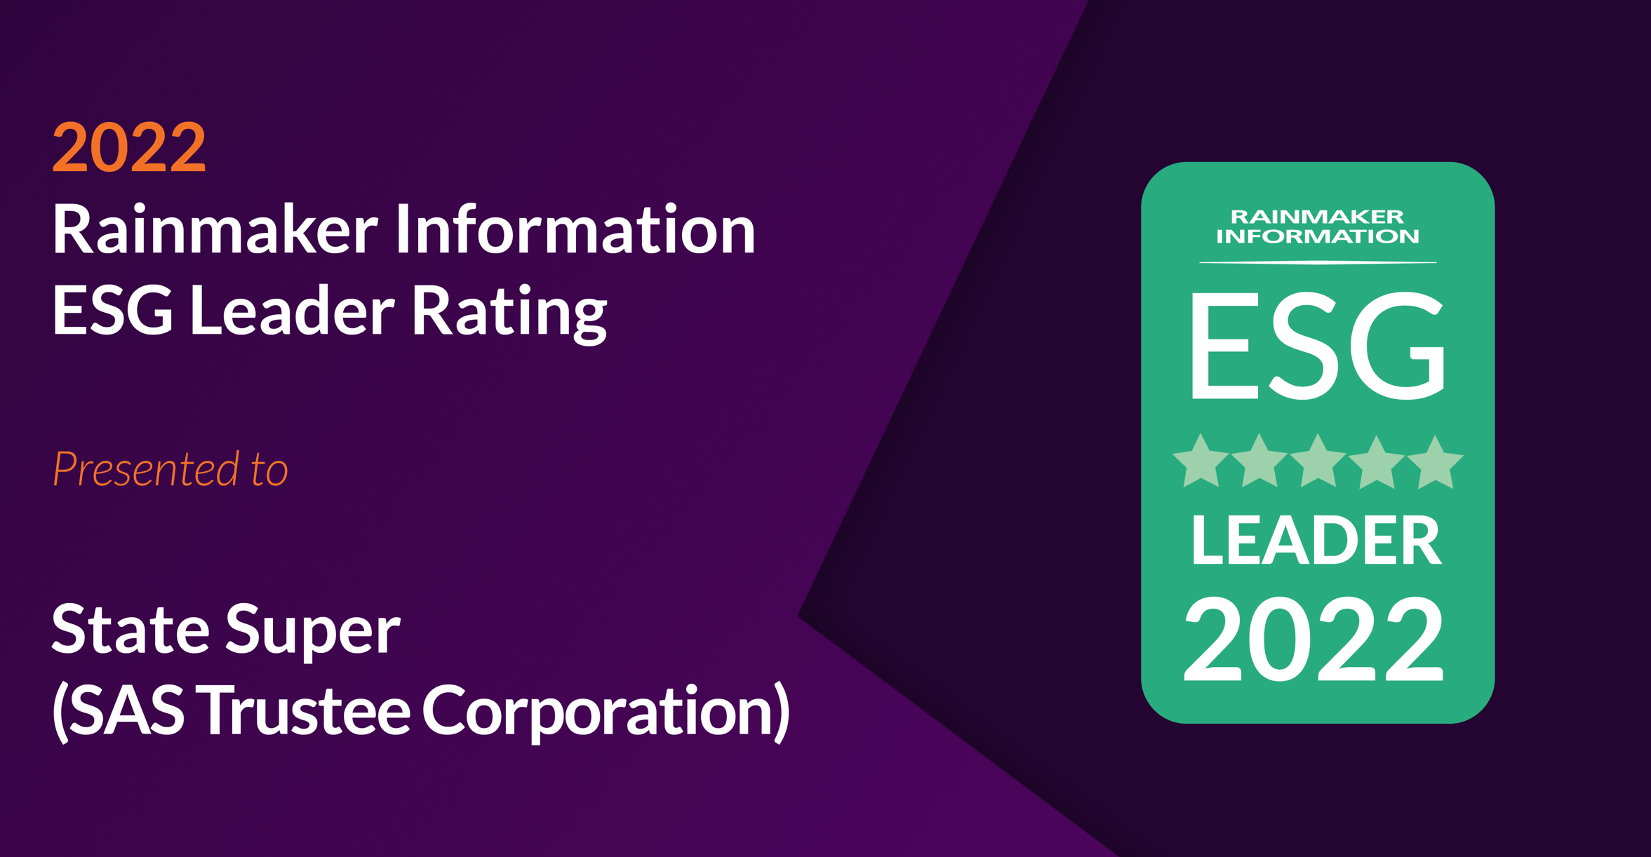
Net zero and esg
Recognised by Rainmaker as an Environmental, Social and Governance Leader in 2022.
Notes:
I just wanted to share with you an award we received this year, as and ESG leader, awarded to us by the reputable organisation, Rainmaker Information.
This was awarded to us in recognition of all the work we have undertaking in managing ESG risks including Climate risk.
I am personally delighted that State Super is seen as a leader in this area, and again shows how we are building resilience into the organisation.
I’d like to do a shout out to our team, Charles Wu, Keri Pratt, Jason Hazell, Sarah Gallard (who led our ESG initiatives), Andrew Huang (who are Head of Equities has the most assets by value impacted), Alice Tjadja who as Head of Real Assets has to understand and manage the impact on our operating investments, Alan Chan, who as our strategist has devised our path measures, and Jonathan Chung who as our risk manager, has to measure our progress.
Thank you all

Slide 13
Looking ahead and innovations
State Super has developed a unique set of skills responding to more than a decade of challenges:
Responding to the challenges of managing investments while experiencing negative cashflow;
Mitigating risks in a complete administration systems transition;
Transacting infrastructure assets,
…resulting in superior member and employee engagement and investment returns.
Notes:
Before I hand over the Charles and Nada, who will provide you with our specific investment performance, and our member profile, I want to look to the future.
State Super has a team that are themselves resilient in the face of ongoing challenges. And we also have your input through our forums and our many interactions.
We believe we have been successful in setting and implementing appropriate investment strategies to respond to the need for ambitious investment objectives, with the significant challenge of negative cashflow. We pay out more each month, than we receive. This means we have to constantly rebalance our portfolios, and we don’t have the luxury of new cashflow allowing us to respond to opportunities. And yet, our processes and systems have enable State Super to achieve superior risk adjusted returns. We believe we can and will continue to ably respond to investment challenges.
As members retire, our challenges of managing the retirement process, and in managing those that stay with us as pensioners, continue. Over and above this, over the last few years we have focused extensively in mitigating the risk of transitioning the administration system to a more contemporary one. To date, all stages have been successful, but only because at times, we brought a risk lens, based on our belief that we should always:
Act with fairness, integrity and openness
Make it easy for members to understand their unique scheme
Help members maximise their State Super benefits
Be a trusted guardian of members’ funds
As our members change, we will continue to deliver services to each and every remaining member, understanding that our fund will be operating well into 2080’s.
And our deep experience will enable us to continue to bring innovative solutions and to continue to build resilience into your organisation. Resilience that has enabled State Super to rapidly respond to opportunities to transact assets – such as the sale of Port of Geelong. For the benefit of members.
I’ve highlighted the value of our team in doing all this. Our team works because our people are engaged with servicing you and with working together as a team. This has been shown in successive years with engagement scores far higher than other among comparable organisations.
And time and again shows that a team that works well together for a greater purpose, achieves results for members. And our member research has shown time and again, extremely high levels of satisfaction with the services and investment returns we achieve.
Now I’ll hand over to Charles to talk abut Investments and then Nada who will talk about the Member Experience

Slide 14
Thank you!

Slide 15
Investment performance member meeting 2022
Charles Wu, Chief Investment Officer

Slide 16
The year in review
DC Growth Performance against SuperRatings median peer fund (annual financial year end returns to 30 June)
Source: Frontier, SuperRatings, STC. Returns are calculated on an after fees and taxes basis.

Slide 17
The year in review

Slide 18
Managing capital in challenging environments

Slide 19
Strategic Asset allocation

Slide 20
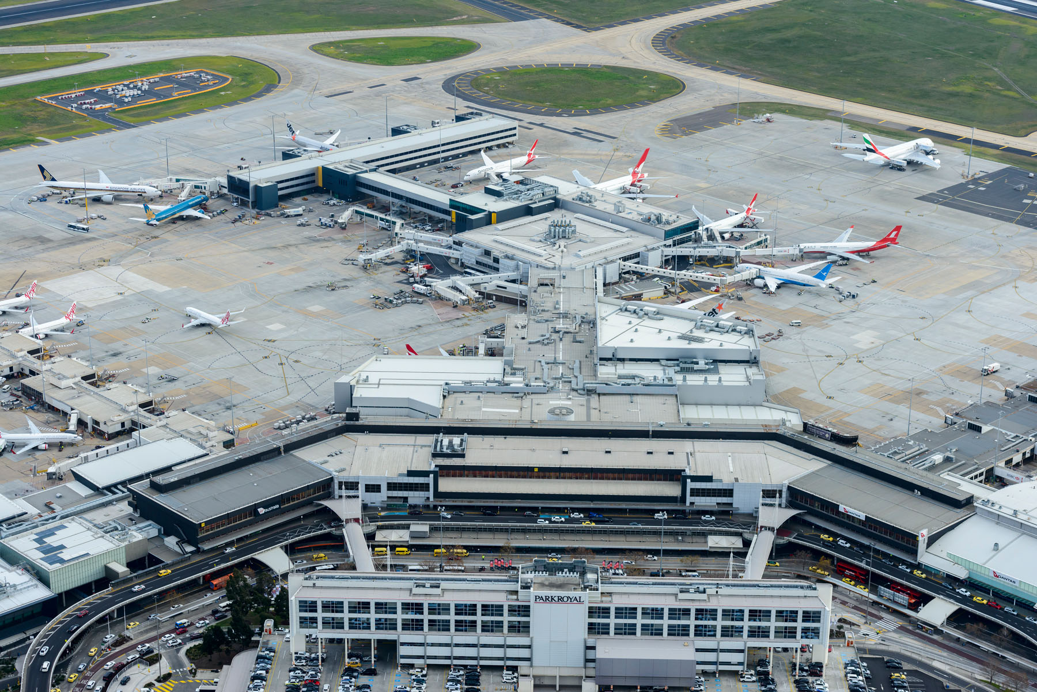
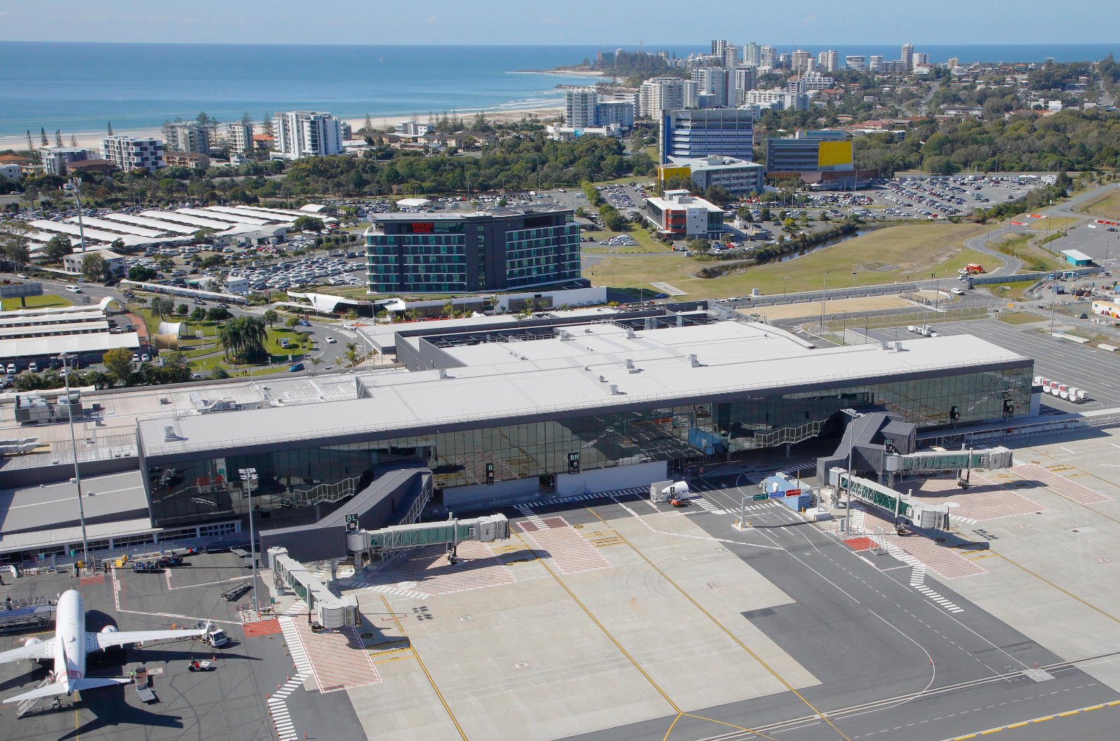
Our assets
Gold Coast Airport
Melbourne Airport

Slide 21
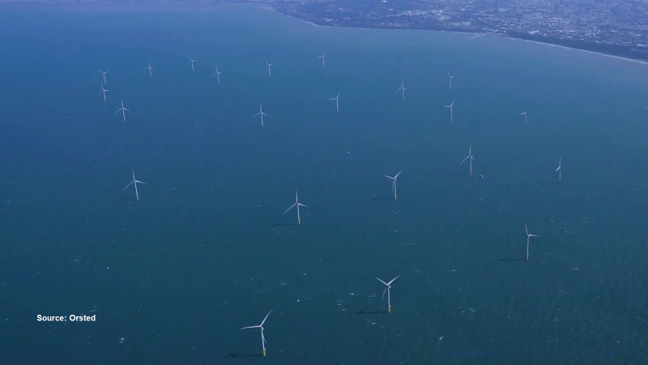
Our investments

Slide 22
Thank you!

Slide 23
Member ENGAGEMENT UPDATE member meeting 2022
Nada Siratkov, Chief Experience Officer

Slide 24
103 years old
State Super marked 100 years of the organisation in 2019.
NSW Government started the scheme on 1 July 1919 under the Superannuation Act (1916).
Compulsory for permanent, salaried employees of the NSW public service and teaching service.
Provided for a “Defined Benefit” pension at retirement (and invalidity/death pension).
Reversionary pension for the female spouses of members.

Slide 25
Our dna
1919
1919 - 1985
1985 - 1988
1988 - 1996
1996 - present
State Superannuation Board
State Authorities Superannuation Board
State Provident Fund Management Board
State Public Service Superannuation Board
State Super (SAS Trustee Corporation)

Slide 26
What your member engagement team does
To deliver relevant and reliable member experiences including:
Taking an integrated approach to managing the member experience
Negotiating and managing material service contracts
Product changes and management
Scheme legislation and interpretation/policy
Marketing and communications
Stakeholder engagement
Disputes management
State Super profile and brand
Member Services Committee
Member Research

Slide 27
Our member beliefs
State Super promises to:
Act in members’ best interests
Act with fairness, integrity and openness
Make it easy for members to understand their unique scheme
Help members maximise their State Super benefits
Be a trusted guardian of members’ funds

Slide 28
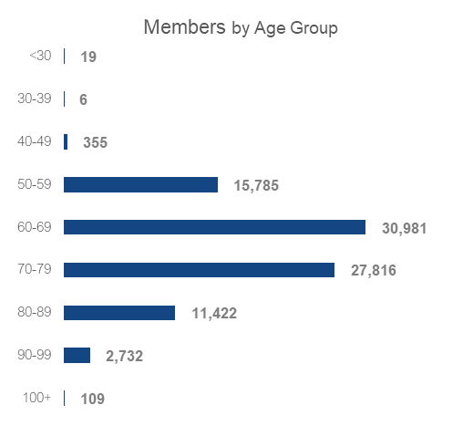
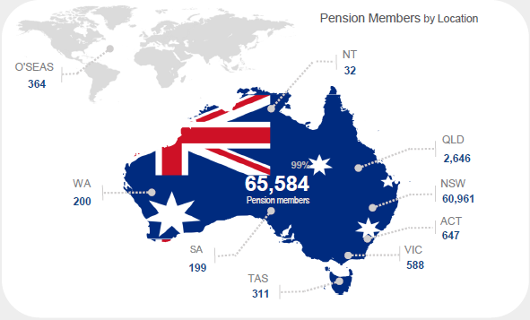
MEMBER SNAPSHOT
Members by Gender
The Centenarians
SASS
SSS
PSS
Pension
Active Members by Industry Sector
3,734
3,672
2,046
1,845
2,856
Health
Education
Emergency
Transport
Others
Youngest Member
Oldest Member
Avg. Age
Avg. Retirement Age
SASS
46
76
58
63
SSS
53
75
60
61
PSS
53
75
57
59
Deferred
46
81
59
63
Pension
18
109
73
61

Slide 29
MEMBER ENGAGEMENT FOCUS & Innovation
Continue to embed the consideration of members best interests in our decision making
Member Advisory Forums
Net Zero & Responsible Investment communication program
Member Experience journey review
Newsletters via digital channels
Website enhancements - member/user audit and enhancements
Research into Pension Member attitudes and needs
Validate and manage the delivery of superannuation administration services to meet member expectations
Maintain an understanding of our member expectations and respond to them through implementation of an effective communication plan

Slide 30
How to engage with us
Call Centre
Face-to-face/Zoom
Website
Research
Customer service inbound & outbound
Retirement Seminars
Personal Interviews
Public website Secure website
Member Satisfaction Survey
Digital campaigns
Publications
Social media
Financial Planning (Aware Super)
Scheme Education
Newsletters
Report to Members
Report to Parliament
State Super LinkedIn

Slide 31
Thank you!

